Slide 1
Understanding Health Patterns: Associations Between Lifestyle, Chronic Disease, and Demographics in the BRFSS Dataset
Team Contributions
Amy Adanse – Developed background information to support the problem statements. Acted as a liaison with the professor and TA to ensure clarity and approval of the dataset and research questions. Documented key meeting takeaways and organized team data through a SharePoint site. Designed the framework for the PowerPoint presentation and overall presentation structure.
Antonio Casas - Contributed to identifying and cleaning the dataset, preparing it for analysis, standardized and removed missing values, assisted with exploratory data analysis (EDA), and developed machine learning models to address questions two and three.
Autumn Wigfall - Contributed to the project by writing the introduction and helping to define the business understanding and problem statement. Additionally, enhanced sections like the exploratory data analysis (EDA), modeling and provided support in organizing and improving the PowerPoint presentation.
Deepeka Gurunathan - Proposed the dataset for analysis, Conducted comprehensive exploratory data analysis (EDA), Examined and visualized numerical and categorical variables, and Analyzed research questions to derive insights during EDA.
Lamin Suso - I contributed by analyzing different machine-learning models on the dataset. Comparing Logistic Regression, KNN, and Random Forest to get answers from our data.

Slide 2

Introduction
Survey Source: The Behavioral Risk Factor Surveillance System (BRFSS) is a nationwide health survey run by the Centers for Disease Control and Prevention (CDC) since 1984
Participants: Adults aged 18 and older who live in private residences or college housing, and come from across the U.S. and its territories
Latest Survey: 2023 BRFSS Dataset
Explorations: The findings from the 2023 survey reveal trends and differences in public health, including how daily physical activity correlates to general health status and the possible benefits it could possess.
Explores how chronic conditions like high blood pressure and high cholesterol differ across income levels and demographic groups, helping us understand how socioeconomic factors impact health.
Looks at how chronic diseases are related to health risk behaviors, such as smoking, poor diet, and lack of exercise, among both men and women.

Slide 3
Question 1: How does the number of days a person engages in physical activity influence their general health status?
American Heart Association (AHA), it examines how major life events and transitions can significantly impact physical activity levels.
Machine learning will also be used to identify patterns and trends in the amount of physical activity and how it correlates with general health.
This approach will display tailored recommendations and interventions for individuals facing challenges with finding time for physical activity.
Business Understanding/Problem Statement

Slide 4
Question 2: How do different income brackets affect the likelihood of being diagnosed with chronic health conditions such as diabetes, high blood pressure, and high cholesterol?
Adults living in poverty are at greater risk of health issues such as obesity, smoking, substance use, and chronic stress, which can lead to conditions like diabetes, high blood pressure, and high cholesterol (Office of Disease Prevention and Health Promotion, n.d.).
Poverty affects the availability of quality food and limits time for physical activities, both of which are crucial to preventing chronic health conditions.
By applying machine learning algorithms, we aim to identify income brackets at higher risk for chronic health conditions, which could lead to targeted preventative care initiatives.
Business Understanding/Problem Statement

Slide 5
Question 3: How do smoking habits and alcohol consumption influence the likelihood of developing chronic conditions such as high blood pressure and high cholesterol?
Smoking and excessive alcohol increase the risk of chronic disease like cancer, heart disease, stroke, diabetes, and liver (CDC 2024)
We will examine how smoking and drinking habits influence the likelihood of developing high blood pressure and high cholesterol.
Using data on smoking, drinking, and chronic disease diagnoses, we will conduct statistical tests to assess the impact of these behaviors on health outcomes.
Business Understanding/Problem Statement

Slide 6
Exploratory Data Analysis (EDA) - Data Cleaning
Data Cleaning:
Identified and renamed specific variables to improve clarity and facilitate the analysis process
Converted all relevant variables to numeric data types
For specific variables, the following codes were used:
Ex: 7, 77, or 777 = “Don’t know”; 8, 88, 888 = “None” or 0; 9, 99, or 9999 = “Missing”
Removed rows containing NA values to ensure that only valid data remained for analysis
Duplicate entries were removed as well.
Standardization:
"Alcohol_Frequency" Variable:
Participants had the option to report either # of days in a week or # of days in the past month
Responses converted to reflect # of days in the past month.
Chronic Health Condition Variables:
Recoded the variables as: No = 0 and Yes = 1
Results:
The dataset was reduced from over 400,000+ instances to about 111,000 instances, leaving us with a cleaner and more reliable dataset for analysis.

Slide 7

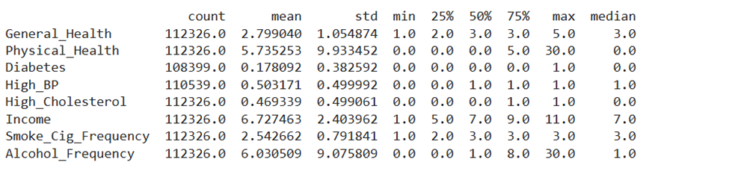
Overview Of The Dataset
The cleaned dataset contains 112,326 rows and 16 columns.
Composed of 14 numerical, 1 categorical, and 1 time-series variables.
Numerical Variables: State, Gender, General_Health, Physical_Health, Mental_Health, Have_Healthcare_Provider, High_BP, High_Cholesterol, Diabetes, Income, Smoke_Cig_Frequency, Alcohol_Frequency, Age, and Education.
Categorical Variable: Race
Time Series Variable: Date
Once the shape of the dataset is identified, the statistics of the numerical variable are calculated to understand the spread and central tendency of each variable.

Slide 8
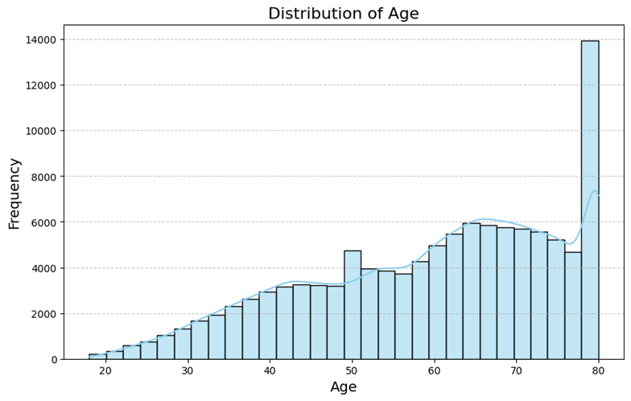
Analysis of Numerical Variable
The population ranges from a wide variety of ages, with a majority being middle-aged going up to older adults between 40–80 years.
Target Demographic: The dataset contains a larger number of records from older people due to the reason chronic conditions are more common in those age groups.
Underrepresentation of Youth: The limited data available for people below 40 years may inhibit insights into the health and lifestyle patterns of younger age groups.
Potential for Bias: The imbalance may, therefore, bias the findings, especially in associating age with health outcomes or behaviors.
This figure represents a histogram with the distribution of ages

Slide 9

Basic Insights of Numerical Variables
Age: The average age of participants is about 55 years, while the median is closer to 60 years, indicating that the participants are older.
Income: The median lies between $50,000-$75,000, while the lowest category (<$10,000) is highly skewed for chronic condition prevalence.
There is a significant dispersion in the standard deviation of Physical_Health and Mental_Health, meaning some participants reported a high number of days spent unwell.
The large Inter Quartile Range in Alcohol_Frequency suggests that there are both occasional and heavy drinkers.

Slide 10
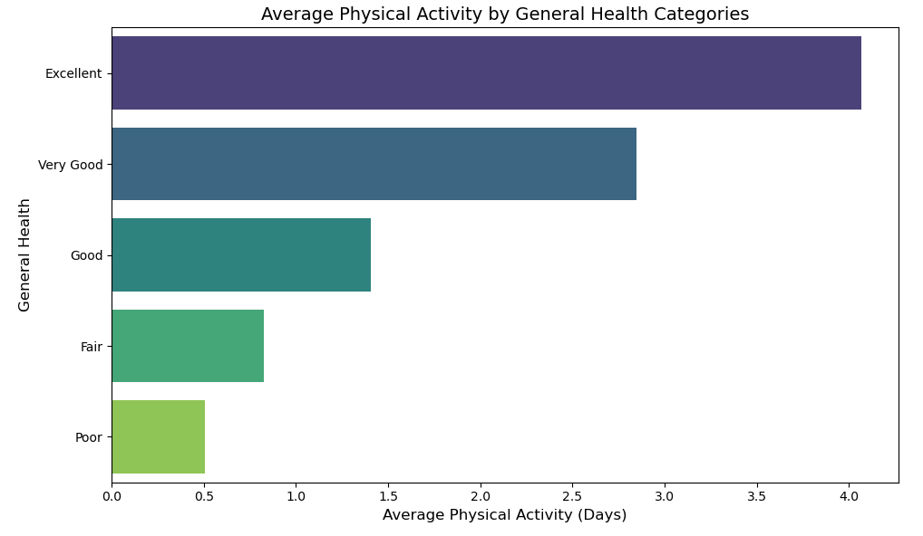

Question 1: How does the number of days a person engages in physical activity influence their general health status?
Dependent Variable: General_Health
Independent Variable: Physical activity (days or frequency of exercise).
This figure represents a bar graph with the Physical activity and General Health

Slide 11
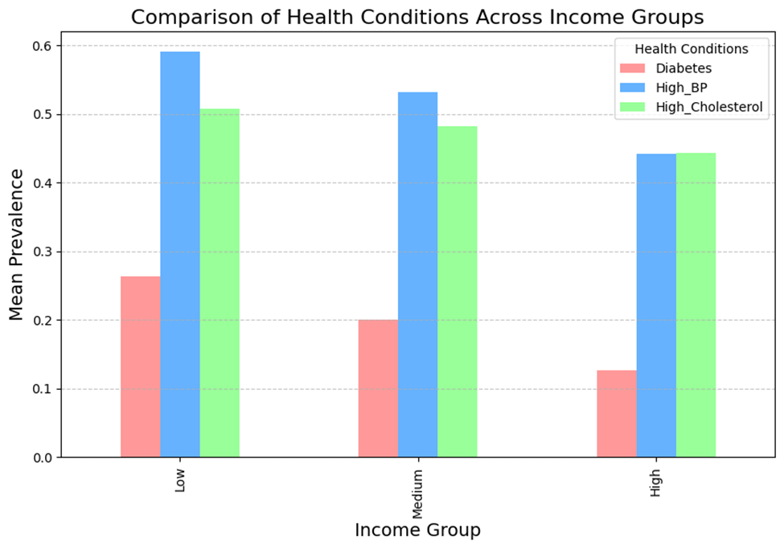
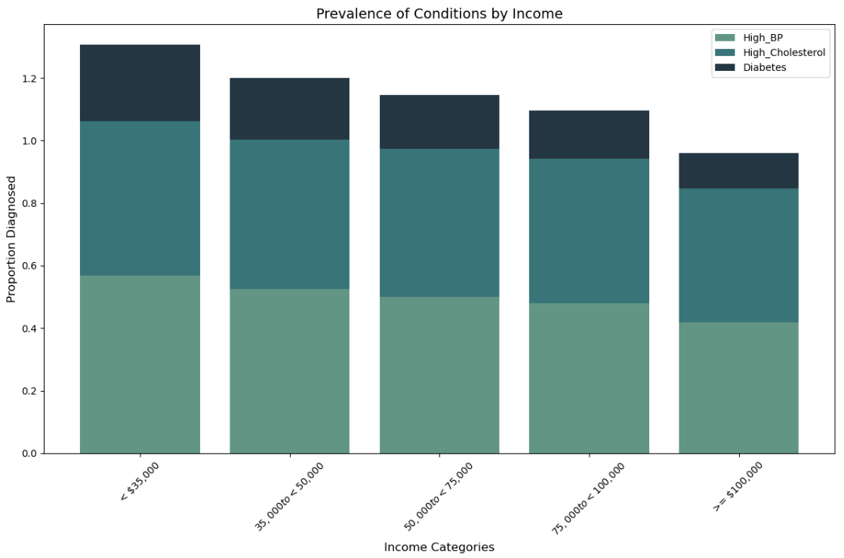
Question 2: How do different income brackets affect the likelihood of being diagnosed with chronic health conditions such as diabetes, high blood pressure, and high cholesterol?
Dependent Variables: Diabetes, High_BP, High_Cholesterol (presence of chronic conditions).
Independent Variable: Income (income brackets).

Slide 12
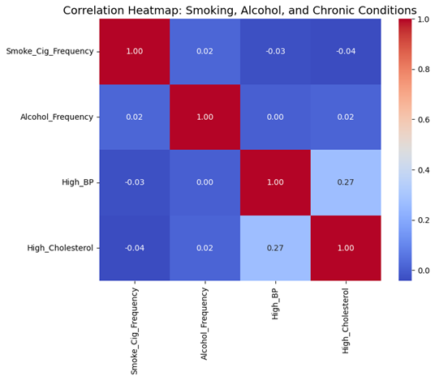
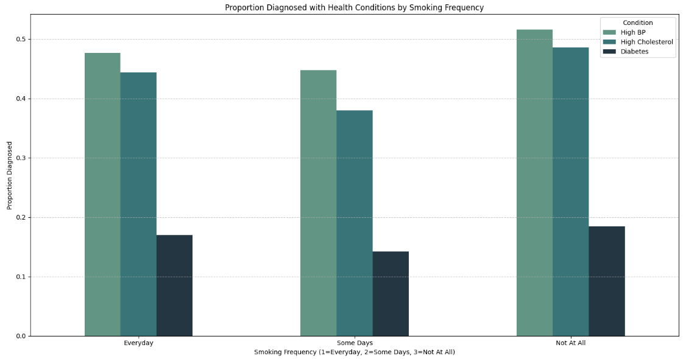
Question 3: How do smoking habits and alcohol consumption influence the likelihood of developing chronic conditions such as high blood pressure and high cholesterol?
Dependent Variables: High_BP, High_Cholesterol.
Independent Variables: Smoke_Cig_Frequency, Alcohol_Frequency.

Slide 13
Random Forest Model for Chronic Health Conditions
Model Objective: Evaluate the impact of Income, Physical Health, Age, Alcohol Frequency, and Smoke Frequency on the prevalence of chronic conditions.
A variety of models were created using different combinations of the feature variables as well as trying both decision tree and random forest models.
The following model achieves the best results:
Model Type: Random Forest
Target Variables:
High Blood Pressure
High Cholesterol
Diabetes
Feature Variables:
Age
Physical Health
Alcohol Frequency
Smoke frequency
Income

Slide 14
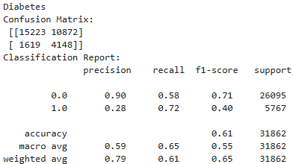
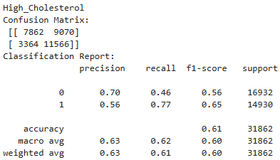
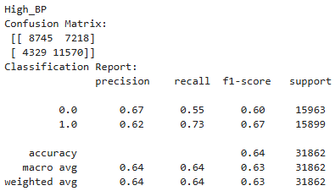
Random Forest Confusion Matrix
Model Results:​
Overall Accuracy: 64% (High Blood Pressure), 63% (High Cholesterol), 61% (Diabetes)​
Recall (Diagnosis = yes)​
73% (High Blood Pressure)​
77% (High Cholesterol)​
72% (Diabetes)​
​

Slide 15

Conclusion
Key Insights: The Impact of Income on Chronic Conditions
Income brackets significantly influence the prevalence of chronic health conditions.
Lower-income groups are at higher risk possibly due to:
Limited access to healthcare
Poor diet
Higher stress levels
Model Implications:
Income-related disparities are strongly associated with negative health outcomes.
The model captures socioeconomic patterns that highlight these inequalities.
Model is consistent with other research done in the field of health disparities.
Behavioral Risk Factors and Chronic Conditions
Smoking Frequency:
Strongly linked to high blood pressure and cholesterol.
Smoking increases cardiovascular disease risk.
Alcohol Consumption:
Excessive drinking impacts cholesterol and blood pressure levels.
Model Insights:
Recall for High Cholesterol: 77%
Smoking and alcohol are critical predictors of chronic conditions.

